Slide 1

WOMEN IN TECHNOLOGY
AnnaMarie fortuna
Jewell Wright
Notes:
This is a presentation promoting the growth of women in technology and why it’s important.

Slide 2

WOMEN IN THE WORKFORCE :
QUERY: ‘SELECT PercentWomen FROM women_workforce WHERE Year = 2016;’
Notes:
The latest data that is available from the department of labor is from 2016 and it shows that women currently make up 46.8% of the overall workforce.

Slide 3

The wage gap
QUERY: ‘SELECT MAX(Women) AS LargestPayWomen, MAX(Men) AS LargestPayMen FROM wage_gap;’
Notes:
However, if we compare the pay differential between women and men. It’s clear that as of late women get paid about 10k less than men per year.

Slide 4

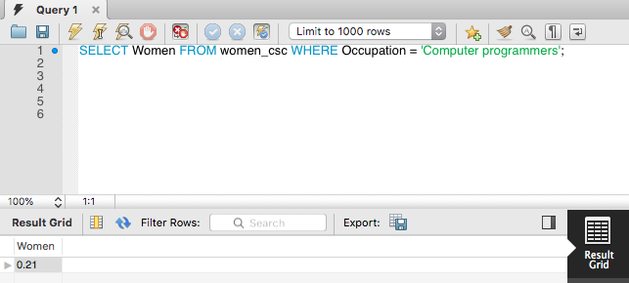
QUERY: ‘SELECT Women FROM women_csc WHERE Occupation = 'Computer programmers';’
Notes:
Directing our attention to the field of computing, women only account for 21% of the field. This is a common theme across all records. The occupations within technology are dominated by males.

Slide 5

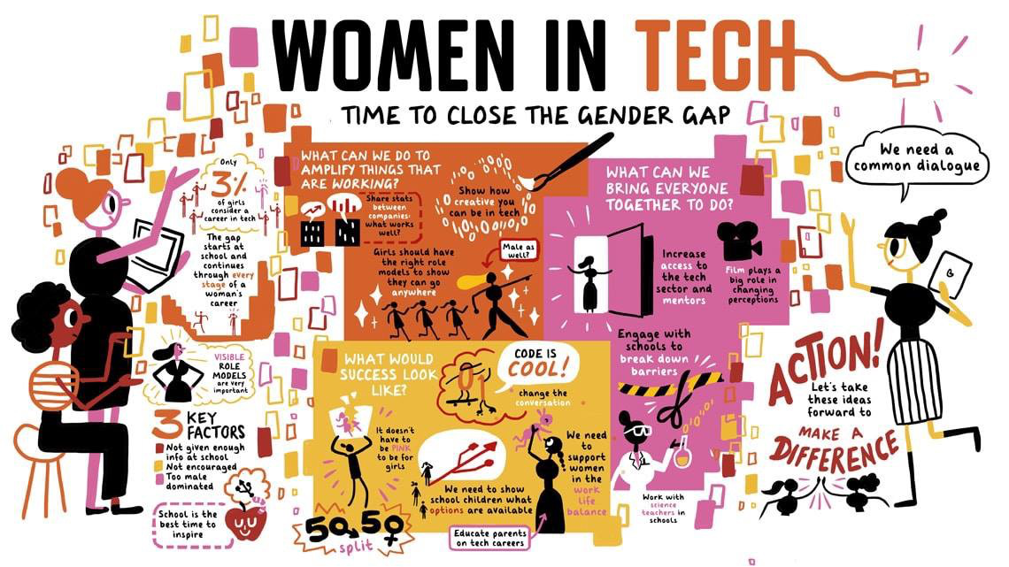
PROJECTED GROWTH RATE:
'SELECT Growth FROM women_growth WHERE Occupation = 'Software developers, applications and systems software’;
Notes:
The department of labor also had predictive data for growth in the field and when we stop to take a look at software development it’s numerical value is at 22%. Thus, if we do some basic algebra then the growth rate for women in computer science is only 4.62%.

Slide 6
CONCLUSION:
It’s imperative that we take measures to encourage more women to enter the field of technology for the sake of equality and progression of the future. Given that women make up about half of the current workforce and yet still get paid roughly 20% less than their male counterparts, it’s clear that for whatever reason their contribution is considered of lesser value. With women underrepresented in the STEM fields, then there is very little hope for change. Technology is what’s driving the advancing of society and the more women that contribute to that advancement, then the more likely they can overcome this stagnation concerning equal pay.
Notes:
Now that women have the right to work. It is necessary for their representation in the fields that matter most.

